Slide 1

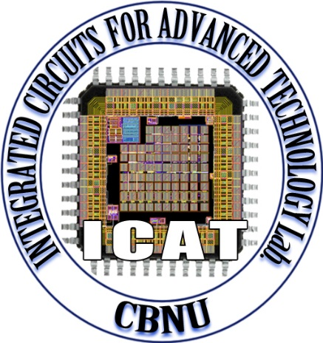

Compact CTR-DRBG Implementation
Through Feedback Techniques
Van Khanh Pham, Chi Trung Ngo, Sang Tran, Ji-Woo Choi and Jong-Phil Hong
School of Electrical Engineering, Chungbuk National University
Introduction
The Counter Mode Deterministic Random Bit Generator (CTR-DRBG) is a cryptographic pseudorandom bit generator
The CTR-DRBG is applied in secure communication protocols, data encryption, and random number generation
The CTR-DRBG can be utilized as a post-processing method to enhance randomness of True Random Number Generators (TRNGs)
The CTR-DRBG function based on block cipher as Advanced Encryption Standard (AES)
Fig. 1. The standard recommendation in NIST SP800-90C for TRNG
Conventional Architecture
Proposed Architecture
Fig. 3. Proposed CTR-DRBG architecture utilizing 256-bit AES
Operation relies on a single AES block
Using the feedback architecture
A counter block keeps track of the iteration time of 256-bit AES
The constant value Y is employed to determine the number of iterations of AES to generate IV_out and Key_out
The Sel signal determines whether the Data_finish is stored in the temporary register or the output register
Fig. 2. Conventional CTR-DRBG architecture utilizing 256-bit AES
Cost two 256-bit AES blocks to generate the DRBG out
Two 256-bit AES blocks cannot operate simultaneously
Algorithm Description and Verification
Synthesized Results
 | Proposed | Conventional
CMOS Technology (nm) | 180 | 180
Input seed length (bits) | 384 | 384
Output length (bits) | 256 | 256
Frequency (MHz) | 125 | 125
Latency (Clock cycles) | 201 | 332.5
Area (GE) | 64829 | 154881
Power (mW) | 99.3 | 247.8
Fig. 4. Timing diagram of the proposed architecture
Fig. 5. Functional Verification
Table I. Comparison between proposed and conventional architecture
Fig. 6. FPGA Implementation
IV_register increases by 1 after each AES runtime
Y = 3 in this case
Sel = 0 ➔ Data_finish stored in Tem. register
Sel = 1 ➔ Data_finish stored in Out register
Power consumption of approximately 99.3mW
Two times smaller than the conventional design
Area occupation at only 64,829 GEs
Two and half times smaller than the conventional design
Conclusion
A compact hardware architecture of CTR-DRBG is proposed by employing a feedback method, which significantly reduces hardware requirements to only a single instance of the AES block for implementation
Area occupation is reduced by two and half times compared to the conventional architecture
Power consumption is reduced by more than two times compared to the conventional architecture
Acknowledgements
This research was supported by Mid-Career Researcher Program through the National Research Foundation of Korea (NRF) funded by the MSIT(Ministry of Science and ICT) (NRF- 2021R1A2C2005258).
This work was supported by Innovative Human Resource Development for Local Intellectualization program through the Institute of Information & Communications Technology Planning & Evaluation(IITP) grant funded by the Korea government(MSIT)(IITP-2024-2020-0-01462).
The chip fabrication and EDA tool were supported by the IC Design Education Center(IDEC), Korea.

